Slide 1
Subset Construction
https://github.com/wktipton/CS475G8
Noah Morgans, Daniel Tsark, Will Tipton
Group 8
dhtsark@crimson.ua.edu, nmorgans@crimson.ua.edu, wktipton@crimson.ua.edu

Slide 2
Problem Statement
Given an NFA N <Q, Σ, δ_{N}, q₀, F> where
Q is the finite set of states.
Σ is the finite alphabet.
δ_{N} : Q × (Σ ∪ {ε}) → 𝓟(Q), where 𝓟(Q) is the powerset of Q.
s₀ ∈ Q is the initial state.
F ⊆ Q is the set of final states.
convert to its equivalent DFA D <Q’, Σ, δ_{D}, s₀, F’> where
Q’ is the finite set of states.
Σ is the finite alphabet.
δ_{D} : S × Σ → S is the transition function.
s₀ is the initial state.
F’ ⊆ S’ is the set of accepting states or final states.
and L(D) = L(N).
Notes:
Noah

Slide 3
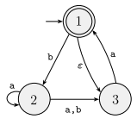
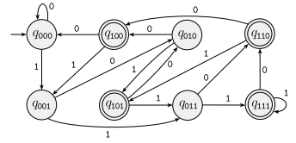
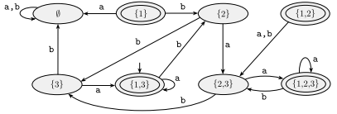

Motivation
NFAs can be easier to construct than DFAs.
They can take a step without reading an input symbol (epsilon).
They can transition to more than one state on a given symbol (non-determinism).
There is no need to visualize every transition.
DFAs can be more efficient to execute than NFAs.
DFAs have exactly one transition on an input, whereas NFAs can have multiple.
This means a DFA can process each input in constant time, and a string in O(n).
Since we must compute multiple threads in an NFA, time complexity is exponential.
NFA over {0, 1} accepting strings containing a 1 in the third position from the end.
DFA over {0, 1} accepting strings containing a 1 in the third position from the end.
Notes:
Noah

Slide 4
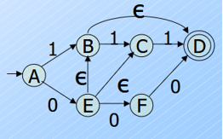
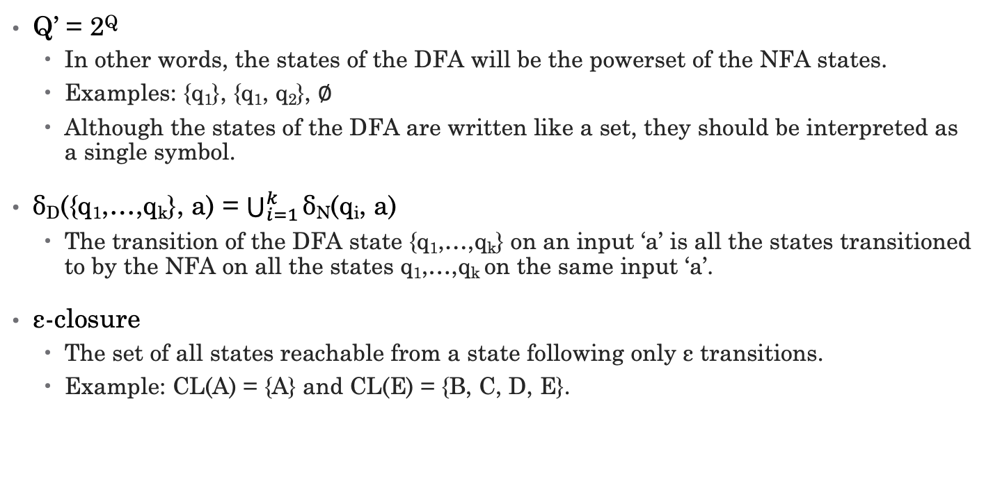
Definitions
Q’ = 2^{Q}
In other words, the states of the DFA will be the powerset of the NFA states.
Examples: {q₁}, {q₁, q₂}, ∅
Although the states of the DFA are written like a set, they should be interpreted as a single symbol.
δ_{D}({q₁,…,q_{k}}, a) = $\bigcup_{i=1}^{k}{\text{δ}}$_{N}(q_{i}, a)
The transition of the DFA state {q₁,…,q_{k}} on an input ‘a’ is all the states transitioned to by the NFA on all the states q₁,…,q_{k} on the same input ‘a’.
ε-closure
The set of all states reachable from a state following only ε transitions.
Example: CL(A) = {A} and CL(E) = {B, C, D, E}.
Notes:
Noah

Slide 5
Algorithm
Step 1: Define an NFA.
Step 2: Make a table of states and transitions.
Start by adding the start state, mark it appropriately, and add its transitions as the first row. Add states transitioned to from start state as next rows in the table. Iterate until no new states are transitioned to.
If there are epsilon transitions in the NFA, define states and transitions as their epsilon-closure.
Any subset that contains a final state from the NFA is marked as a final state.
Step 3: Use the transition table to create a DFA.

Slide 6
Implementation
Code files:
nfa.py
dfa.py
convert.py
dfa_graph.py
main.py
Makefile
nfa_parser.py

Slide 7
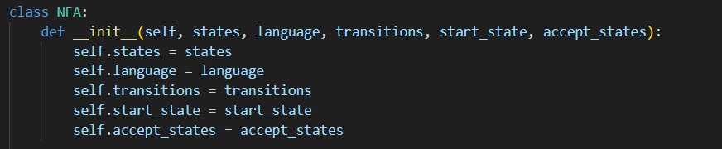
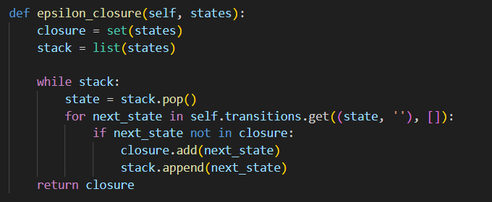
nfa.py
Defines the NFA structure:
states, language, transitions, start state, and accepting states.
Computes all the states reachable via ε-transitions. This is used to define DFA states when the NFA includes ε.
Notes:
Will

Slide 8
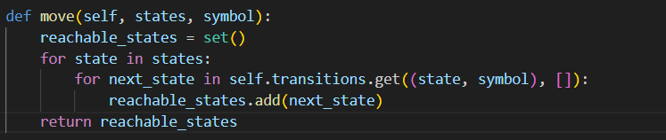
nfa.py continued
This function finds all states reachable on a given input symbol from a set of states
δ(q, a) in NFA formal definition
Notes:
Will

Slide 9

dfa.py
Simple structure to hold DFA states, transitions, and accept states
Notes:
Will

Slide 10
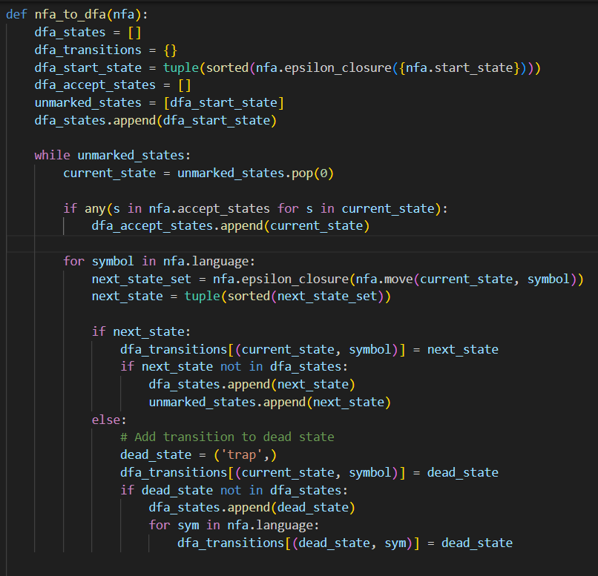
convert.py
The unmarked_states loop implements the subset construction algorithm:
Start with the ε-closure of the start state.
Expand each DFA state by computing transitions using move() and epsilon_closure().
Track unvisited DFA states and generate transitions.
Also adds a trap state for completeness.
Notes:
Will

Slide 11
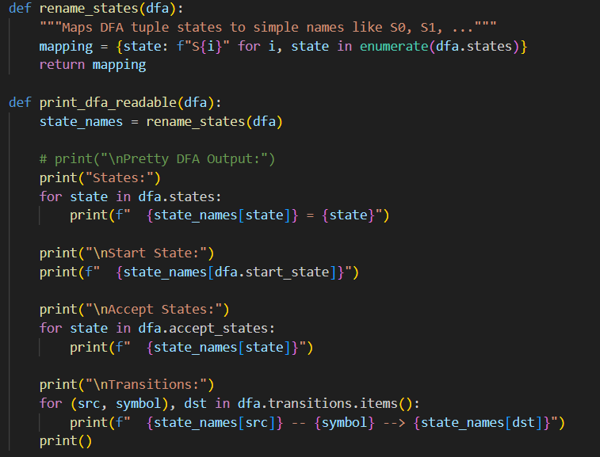
dfa_graph.py
Makes the DFA output easy to interpret in the terminal
Renames complex tuple states to simple names (S0, S1, etc)
Notes:
Will

Slide 12

main.py
This is the entry point: it loads and NFA from a file, converts it to a DFA, and prints the result
Notes:
Will

Slide 13
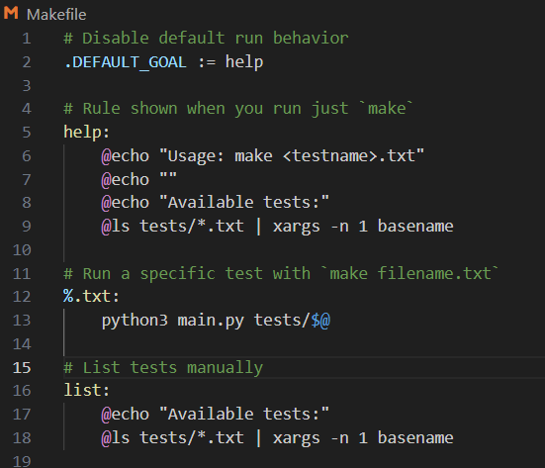
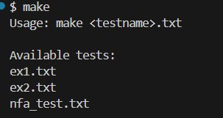
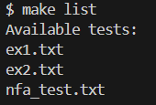
Makefile
echo → prints messages
@ → hides the command from being printed by make
Notes:
Will

Slide 14
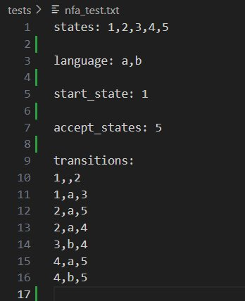
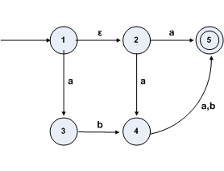
How an NFA is defined in Code
nfa_test.txt
NFA
Epsilon Transitions are written as blanks (as seen in the first transition)
Notes:
Will

Slide 15
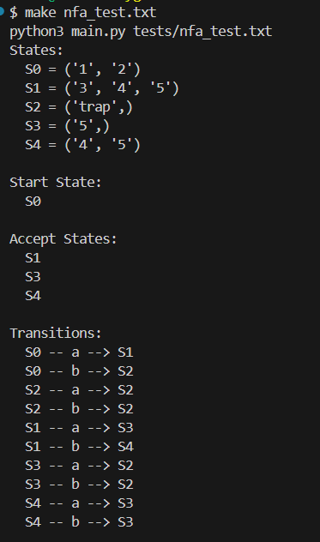
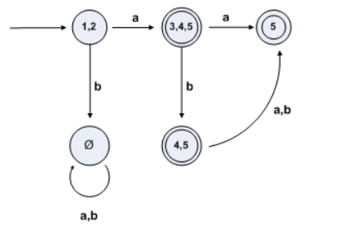
DFA Output
DFA
Notes:
Will

Slide 16
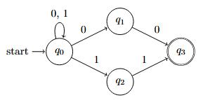
Experiments
 | 0 | 1
->{q₀} | {q_{0,} q₁} | {q_{0,} q₂}
{q_{0,} q₁} | {q_{0,} q₁, q₃} | {q₀}
{q_{0,} q₂} | {q₀} | {q_{0,} q₂, q₃}
{q_{0,} q₁, q₃} * | {q_{0,} q₁, q₃} | {q₀}
{q_{0,} q₂, q₃} * | {q₀} | {q_{0,} q₂, q₃}
Notes:
Daniel

Slide 17
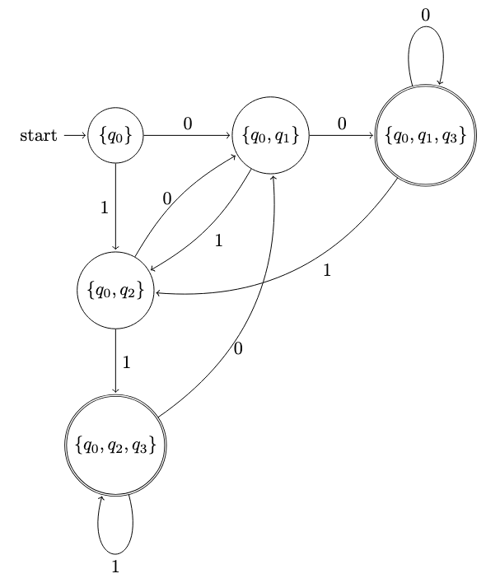
 | 0 | 1
->{q₀} | {q_{0,} q₁} | {q_{0,} q₂}
{q_{0,} q₁} | {q_{0,} q₁, q₃} | {q₀}
{q_{0,} q₂} | {q₀} | {q_{0,} q₂, q₃}
{q_{0,} q₁, q₃} * | {q_{0,} q₁, q₃} | {q₀}
{q_{0,} q₂, q₃} * | {q₀} | {q_{0,} q₂, q₃}
Notes:
Daniel

Slide 18
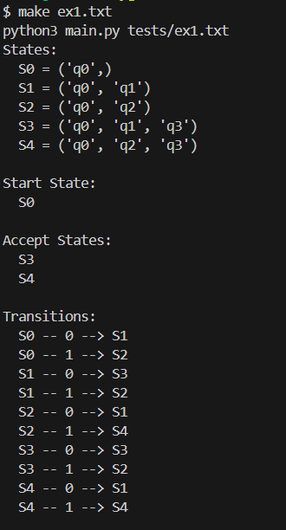
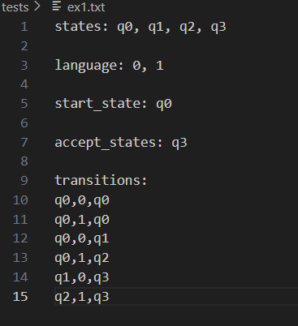
Notes:
Will

Slide 19
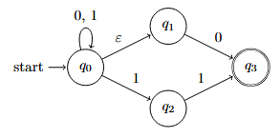
Experiments
 | 0 | 1
->{q_{0,} q₁} | {q_{0,} q₁, q₃} | {q_{0,} q₁, q₂}
{q_{0,} q₁, q₃} * | {q_{0,} q₁, q₃} | {q_{0,} q₁, q₂}
{q_{0,} q₁, q₂} | {q_{0,} q₁, q₃} | {q_{0,} q₁, q₂, q₃}
{q_{0,} q₁, q₂, q₃} * | {q_{0,} q₁, q₃} | {q_{0,} q₁, q₂, q₃}
Notes:
Daniel

Slide 20
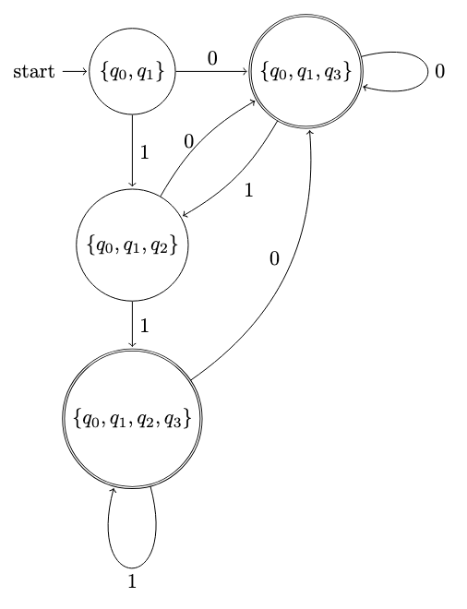
 | 0 | 1
->{q_{0,} q₁} | {q_{0,} q₁, q₃} | {q_{0,} q₁, q₂}
{q_{0,} q₁, q₃} * | {q_{0,} q₁, q₃} | {q_{0,} q₁, q₂}
{q_{0,} q₁, q₂} | {q_{0,} q₁, q₃} | {q_{0,} q₁, q₂, q₃}
{q_{0,} q₁, q₂, q₃} * | {q_{0,} q₁, q₃} | {q_{0,} q₁, q₂, q₃}
Notes:
Daniel

Slide 21
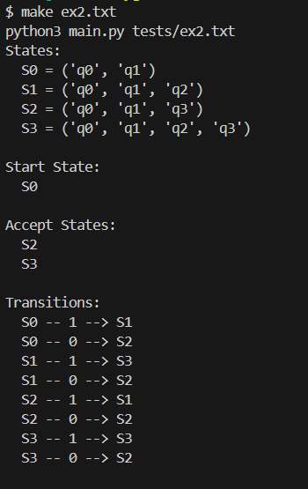
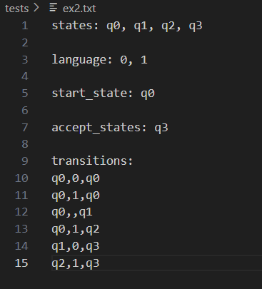
Notes:
Will

Slide 22
Sources
https://condor.depaul.edu/glancast/444class/docs/nfa2dfa.html
https://joeylemon.github.io/nfa-to-dfa/
https://drive.uqu.edu.sa/_/mskhayat/files/MySubjects/20189FS%20ComputationTheory/Introduction%20to%20the%20theory%20of%20computation_third%20edition%20-%20Michael%20Sipser.pdf
https://mrce.in/ebooks/Automata%20Theory,%20Languages,%20&%20Computation%20Introduction%203rd%20Ed.pdf
Professor Ghosh Lecture 7
Repo: https://github.com/wktipton/CS475G8

